Slide 2
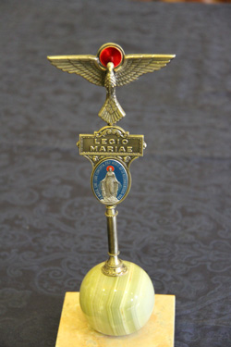
Presdium
Matakatifu
Legio Mariae of African mission church

Slide 3
Presdium
Matakatifu
Legio Mariae of African Church Mission

Slide 4
























Legio Maria
Legio Maria
Song Book
Song book
Legio Mariae of African Church Mission

Slide 5
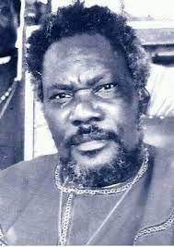
PUONJ BABA
Teachings of Simeo the Messiah

Slide 6
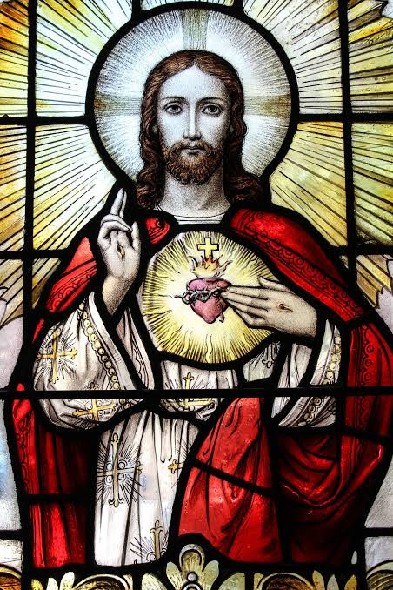
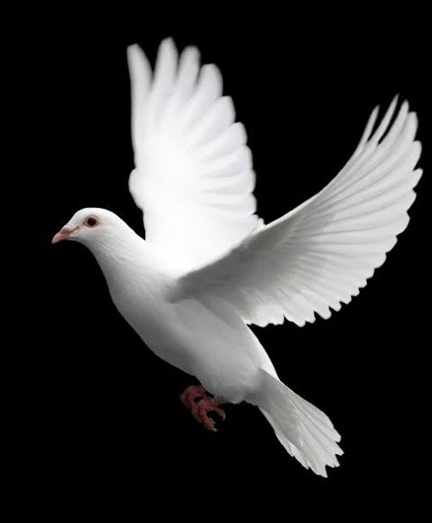
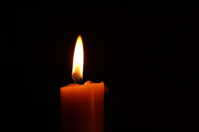
The Holy Mass prayer book
Legio Mariae of African Church Mission

